Slide 1
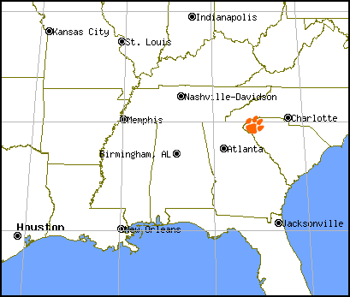
Let’s Get Connected!
How Clemson University uses Adobe Connect to facilitate Distance Education, Meetings, Support and Online Training
Jan Lay and Steve Nodine
Customer Relations and Learning Technology
Clemson Computing and Information Technology
Clemson, SC USA
Notes:
Hi! My name is Jan Lay and I am from Clemson, SC which is on the Atlantic side of the continent. Clemson is a little town between Atlanta, GA and Charlotte, NC and is the home of Clemson University where I work in the IT Department. Specifically, I work for Customer Relations and Learning Technologies and I am a software trainer for the Adobe Creative Suite which includes Dreamweaver, Flash and Photoshop.
Since Adobe Connect was initially purchased for use on our campus in 2003 (and at that point it was known as Macromedia Breeze) our IT department has seen the use of Adobe Connect increase dramatically…not only within DE, but for a number of other uses. This presentation documents the addition of Adobe Connect to Clemson’s online tools and how this particular tool is being utilized across our campus.
Although this presentation is not designed to teach you how Adobe Connect works, I and one of my colleagues (who will be joining us at the end of this presentation from SC), will be using Adobe Connect to show you how you can use this tool to “reach out and touch someone”…and then the audience will be invited to join in for a collaborative game of tic tac toe! Why tic tac toe? Well, because we figured everyone would know how to play that, and everyone might not know how to solve a quadratic equation…

Slide 2
Increased Adobe Connect Use
at Clemson University
Cost
Compliance
Convenience
Notes:
As I just said, Adobe Connect was introduced to the Clemson campus in 2003, primarily as a lower cost, more efficient way than Video Conferencing to facilitate synchronous information sharing and collaboration in our Distance Education classes. In 2003, Clemson University bought licenses for 200 concurrent users. Because of the increase in users between then and now, we have switched to a different licensing model which has no concurrent user limit. Although we don’t directly monitor all uses of Adobe Connect, there were over 600 web conferences on record for the 2006-07 academic year,
So, why has there been such a dramatic increase in use? Well, three major factors have driven up the demand:
First of all, the Cost savings: in addition to the initial cost savings over video conferencing, people have discovered that Adobe Connect can significantly reduce the time and money they spend traveling to meetings, both near and far.
Second, there are Compliance issues: Last year a federal law was passed which mandated that people on the GI bill taking Distance Education classes needed synchronous time with their classmates and/or professors at least once per week. Although Scype, IM, and chat sessions are also used to comply with this regulation, Adobe Connect is another popular choice.
Finally, there is the Convenience factor: Anyone who has a computer, with an internet connection of at least 56K (although DSL or broadband is recommended) can participate in an Adobe Connect meeting.

Slide 3
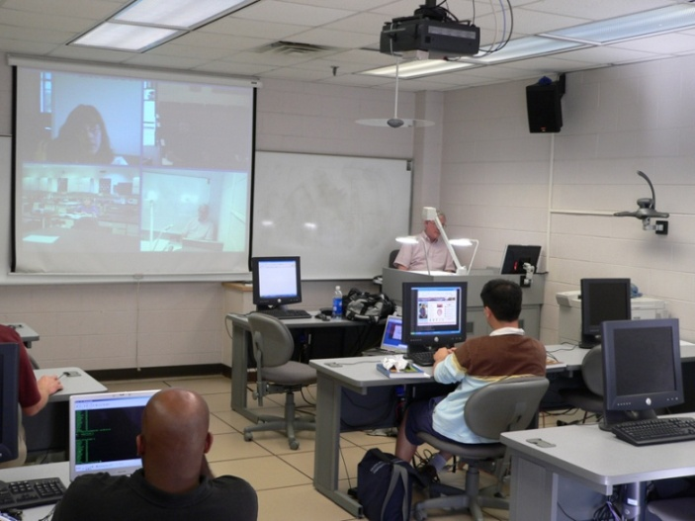
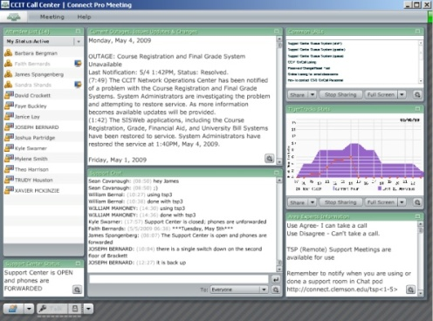
Increased Adobe Connect Use
at Clemson University
Distance Education
Meetings
Computer Support
Online Training
Notes:
The four major areas of often overlapping use that we have seen develop on the Clemson campus can be divided into:
Distance Education
Meetings
Computer Support
Online Training

Slide 4
The Various Forms of
Distance Education
then
Dedicated, mostly asynchronous classes
Taught-from-a-Distance classes
Multiple Instructors in Multiple Locations
Guest Speakers
One-off Classes
now
Notes:
The first area that I’m going to talk about is Distance Education, because…as you might expect…various forms of distance education and online classroom delivery remains the top use of Adobe Connect on the Clemson campus.
Over the past several years, the number of online classes that Clemson offers has grown tremendously. Although Distance Education was first used to describe the dedicated, mostly asynchronous online classes offered to students who were not able to attend regular classes on campus, the concept of “distance education” has expanded to included courses that are simultaneously taught from a distance as well as in a classroom, those which have multiple instructors and students housed in different geographic locations, those which are “regular classes” but which have guests who present lectures from a distance, and those which are taught on a “one-off” basis via Adobe Connect if the instructor is…for example… out sick, or while travelling.

Slide 5
Basic vs. Intensive Use
Of Adobe Connect
Basic Adobe Connect Use
Audio lecture
Visual Materials
Q/A via Chat
Intensive Adobe Connect Use
Video
Whiteboard
Break-out rooms
Polls
Screen/computer Sharing
Notes:
As with any tool, some of our instructors use Adobe Connect in a very basic way. This means that they would most likely have an audio lecture while they presented various visual materials through the share pod, then they would allow questions to be asked via the chat pod.
Other instructors, however, will utilize the video, whiteboard tools, break-out rooms, polls and the screen and computer sharing tools to provide a richer, more intensive interactive learning environment for their students

Slide 6
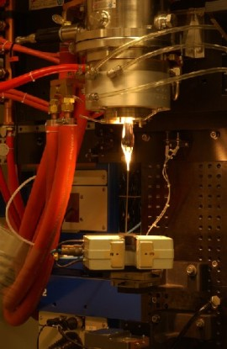
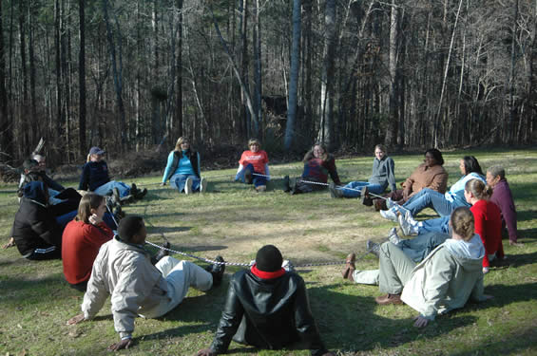
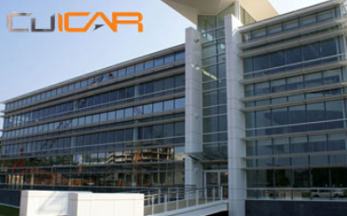
Using Adobe Connect for
Distance Education
Dedicated DE Classes
Collaborative Classes
Hybrid Classes
Notes:
Now I’m going to share several examples of how Adobe Connect has been used at Clemson in three different types of Distance Education. In all of these examples, Adobe Connect was used in a manner that went beyond just the basics and/or was used in a way to facilitate a need that would otherwise not be met.
My first example is with the Dedicated DE classes offered in the Master’s in Youth Development program: The 2-year Master’s In Youth Development Leadership is an online program of study within the College of Health, Education, and Human Development. This degree was first offered in 2004 to the administrators of the Boys and Girls Club of America. It is now offered to anyone who wants to assume a position of leadership in youth development organizations, agencies, and institutions.
Dedicated DE Classes: When Dale Layfield was teaching his online computer classes to the Youth Development students, he made extensive and innovative use of most of the Adobe Connect tools. While it is common for an instructor to share his or her desktop with students to demonstrate some point, Dale also had his students take control of HIS computer where they would be asked to repeat something they had just been shown. Dale also used the “breakout feature” of the chat pods to form discussion groups. When the discussion time period was over with, a representative from each of the breakout groups would have to present their group’s thoughts to the entire class. Dale also came up with a way for students to search back through recorded Adobe Connect sessions to find key points that had been made during that session. He called this process the “active lurker.” Simply put, a student lurker was designated for each class session, and that student was responsible for making time and topic notations in the chat window as key points were covered. The transcript of the chat session was then posted online, along with the recordings, so students could easily jump to sections they wanted to review.
My second example is in the Materials Science and Engineering Department: Collaborative Classes: A couple of years ago, at a meeting of the Glass Division of the American Ceramic Society, university faculty members were discussing how unfortunate it was that they, individually, didn’t have enough enrollment to teach advanced glass classes. From that discussion was born a virtual collaborative class with enrollments from 10 institutions.
Clemson materials science and engineering professor Eric Skaar offered to host the virtual class using Clemson’s Adobe Connect Web conferencing technology. Each university provided a lecturer who took turns as the primary instructor. One lecturer, who was on sabbatical, was able to deliver his presentation from the Netherlands. Instructors found that collaborating across institutions for projects was not only feasible but in some cases preferred by students because of the collaborative environment. The faculty has now taught the course twice with about 40 students in each section.
My remaining examples are of hybrid classes: Hybrid Classes: The first three of these examples are also from the Materials Science and Engineering Department. In one of these classes, Materials Processing, adjunct professors from the Savannah River Site are responsible for teaching various sections of the course. Because of the distance between Clemson and the Savannah River site (120 miles), their lectures were always given remotely. In a Materials Statistics course, the instructor (who was also housed at the Savannah River site) primarily taught via Adobe Connect and only came to the Clemson campus once every two weeks. Eric Skaar, for his Electronic Materials class, decided to give Friday lectures to his students so that their weekend time would be more flexible. My last hybrid example is of some classes that are taught from our CU-ICAR automotive engineering facility near Greenville, SC. Although considerably less than 120 miles, the 40 miles between our two campuses is enough to warrant these classes being offered simultaneously on the CU-ICAR campus, but also via Adobe Connect so that the Clemson students don’t have to drive to attend the classes.

Slide 7
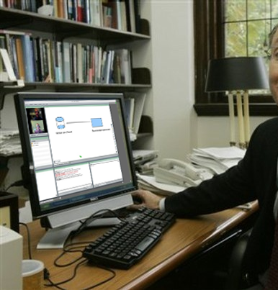
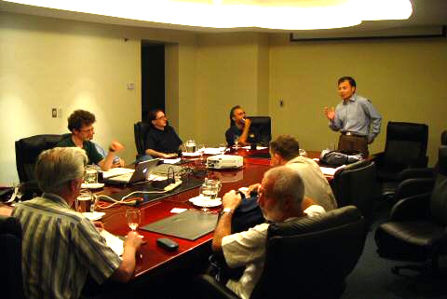
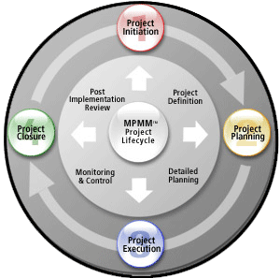
Meetings Facilitated by Adobe Connect
On Campus Meetings
Project Meetings
Virtual Office Hours
Notes:
Now I am going to tell you about a couple of uses that are not connected to Distance Education but rather show how Adobe Connect can help address particular problems.
Campus Meetings: The first problem, is that of “campus meetings.” Meetings on a college campus are the bane of most people’s existence…in large part because of the time and effort it can take to merely get to and from them. The Clemson campus, while not overly large, does have a number of remote locations. As our faculty and staff have become more familiar with the use of Adobe Connect for Distance Education purposes, its use for ordinary meeting attendance has increased. A number of regularly scheduled campus meetings, including our own Department’s Teaching with Technology meeting, are now delivered through an Adobe Connect session. This enables meeting participants, who otherwise would not be able to attend, to still “be there.” An added benefit, is the ability to record meeting sessions and save them for future reference.
Project Meetings: On a similar note, the use of Adobe Connect in collaborative or Project meetings is becoming more common. Instead of a number of people from different remote locations (such as the various IT groups which are scattered around the Clemson area) driving miles to one location just to work on the schematics of a project, using Adobe Connect and its file and screen sharing capabilities enables the same collaboration to occur while each participant remains in their own office.
Virtual Office Hours are another fast growing type of Adobe Connect use. Not only do Virtual Office Hours benefit students by allowing them to “visit” their professors without actually going to their office, it also allows a professor to offer office hours from their campus office, home, or even when travelling.
*note: negative connotations about “chat”…However, the group decided to stop and meet face-to-face instead because the IT project’s client did not want his employees to meet in a “chat room.”

Slide 8
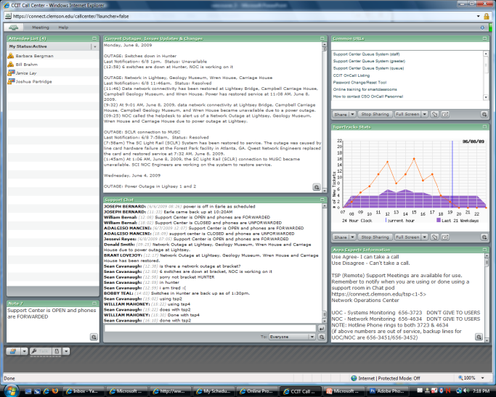
Using Adobe Connect for Computer Support
Monitor Support Calls
Remote Access
Technique Demonstration
Notes:
Another way that Adobe Connect has been successfully used on Clemson’s campus is in the area of computer support.
At this point, all of our Support Calls are monitored via an Adobe Meeting room which contains pods for:
Current Outages, Issues Updates and Changes
Common Support URLs
Support Chat
Ticketing Statistics
Experts Info
When a ticket comes in that is difficult to resolve via email, customers are offered “live” meeting room support to help them troubleshoot problems
If a customer can’t use the Chat room at that moment, they can schedule Adobe Connect help at a time that is more convenient for them
The most positive aspects of using Adobe Connect for computer support are that:
It cuts down on confusion caused by misunderstood terminology
The customer can be walked through problem solving on their own computer or, support personnel can demonstrate a correct technique while a customer is watching
If the customer is not able to resolve their computer issue with verbal instructions, their computer’s control can be “handed over” to a remote support person so that a problem can be fixed quickly.

Slide 9
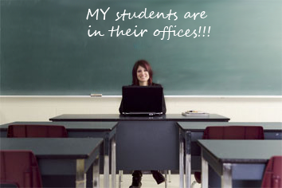
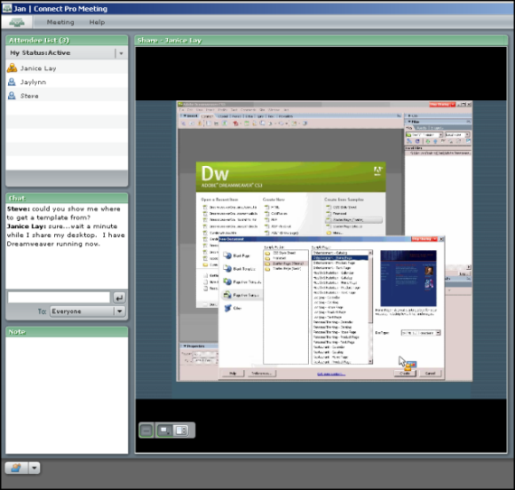
Training, Demos and
Software Support
Online Training
Follow-up Training
Software Support
Notes:
The last category of Adobe Connect use addresses a continuing need for our Training Department to reach more clients, more efficiently. Although CRLT offers a wide variety of Instructor-led Training for faculty, staff and students on Microsoft and Adobe software, Distance Education programs and Blackboard training, it is not unusual for students to either withdraw at the last minute or just not show up for a class. Typically, their reason is that they got a phone call, or a visitor, or they were unable to leave their office in time to make the start of the class.
To help address this problem, we now use Adobe Connect to supplement our normal training in three ways:
The first was the implementation of a pilot program this past fall called Tech Talks:
Tech Talk offered convenient Online Demonstrations of various techniques or tips on technical topics; each Tech Talk was 15-30 minutes long, was followed by a question and answer session, included the use of polls, and were recorded for future reference)
Two other areas of support are also now offered online; the first being…
Follow-up Training: additional sessions to extend or clarify in-class training
And the second being…
Software Support: Remote help with the Software we train and support

Slide 10
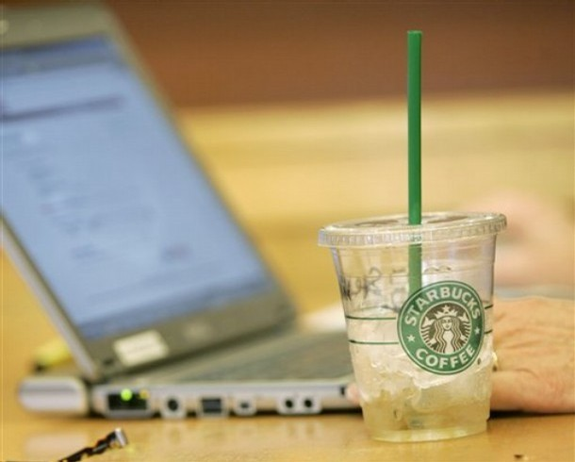
Innovative Uses Of
Adobe Connect
“One-off” Classes
In-class Use
Study Materials
Notes:
Finally, I’m going to tell you about the uses that I discovered which are “innovative” in either scope, or application.
Cancelling Classes: The first, while not terribly exciting (especially to your students) is making the decision to not cancel class while you are away from campus, either because of illness, travel or sabbatical. The two ways that Adobe Connect users address this problem is to either have their class log into an Adobe Connect session at their usual class time and proceed as usual, or to arrange to have a guest lecturer to deliver a class via Adobe Connect. While on sabbatical, Adobe Connect enabled Dr. Luis Echegoyens to continue research collaboration with his graduate students at Clemson during his sabbatical to the National Science Foundation in Washington, D.C.
Recorded Classes: The second use, also not wildly exciting, is related to the “not cancelling class” use. That is, some of our instructors routinely deliver their class presentations through Adobe Connect and an audio feed, and record the entire Connect session as a study resource for their students. Additionally, several of our instructors record review sessions within Adobe Connect and provide those as an additional classroom resource. One instructor, Amy Pope in the Physics department, started this when she was out recovering from the flu right before Final Exams.
In-class Use: The third is a rather innovative use of Adobe Connect…and that is with a laptop class, IN class. In this example, the students bring their laptops to class, log into their instructor’s Adobe Connect meeting, and then proceed with class as usual. However, the tools and computer sharing properties of Adobe Connect gives the instructor the ability to have various students take control of the meeting room to demonstrate a particular learning point.

Slide 11
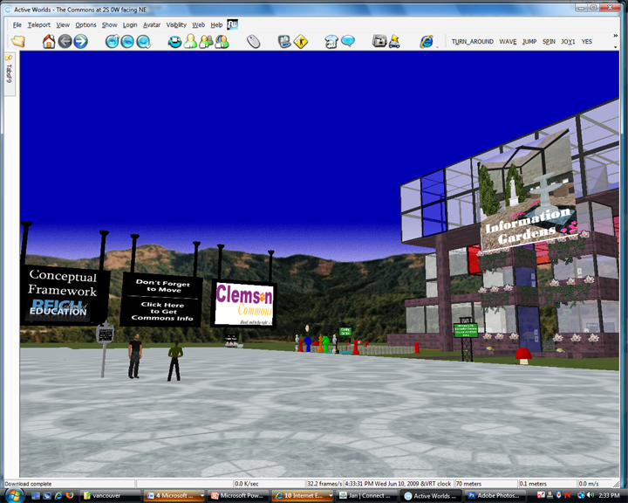
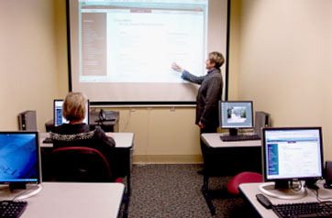
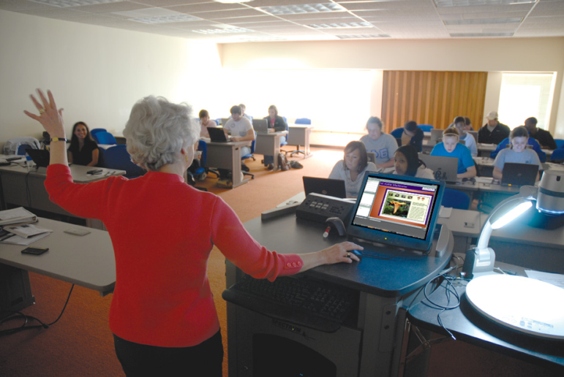
More Innovative Uses Of
Adobe Connect
Webinars
Monitor
Teaching
Virtually Worlds
Notes:
Continuing Education Webinars: Starting with a Forestry Finance class to be taught by Tammy Cushing in July, the continuing education department in forestry is about to dramatically change the way they are going to offer training. In the past, each person taking continuing education classes would likely need 1 or 2 days just to travel to a 1 or 2 day meeting. Obviously, this was very costly in terms of actual dollars spent, travel time incurred and work time lost. This new approach will allow Forestry to offer smaller one hour topics that the students can pick and choose from over the course of a year. Additional “pros” for this are that the webinars will be able to use presenters from all over the country, if not the world… interactivity will be possible through a follow-up question and answer session via the chat room, and participants will be able to sign up for workshops online at the forestry extension website, for only 20 dollars/webinar .
A Projected Use: Monitoring of Student Teachers: Desire to be able to monitor a student teacher’s actual teaching ability by recording their lecture in Adobe Connect.
Embedded Meeting Rooms: The Master of Human Resource Development (MRHD) degree program at Clemson University

Slide 12
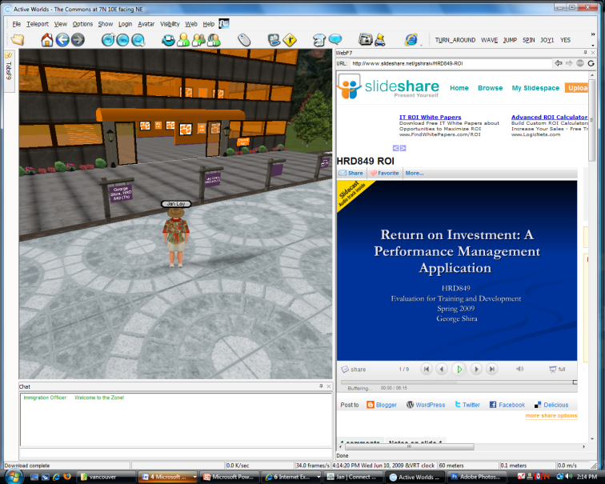
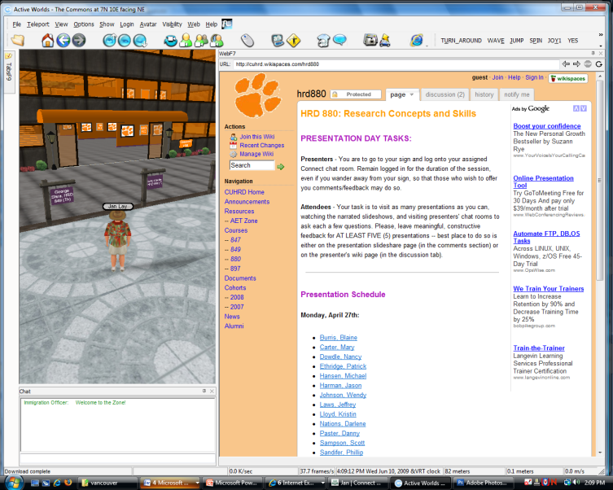
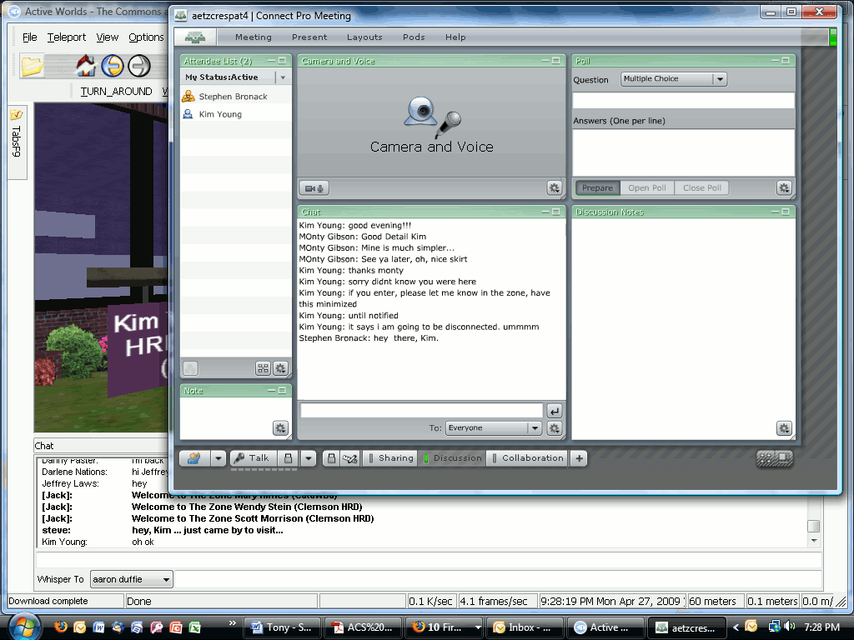
More Innovative Uses Of
Adobe Connect
Notes:
In the Master of Human Resource Development (MRHD) degree program Steve Bronack uses Connect as his primary medium for audio & group interactions with his students. In Connect, schedules times during which groups of students meet with each other – and with Steve – in Connect chat rooms. The students will often use the breakout function to work together on projects. It is typical for classes to start together, then move into group/team breakouts for the majority of the class time. While the students work, Steve will move from breakout room to breakout room to monitor student progress. At the end of the class session, the group will re-conven before exiting the meeting. A unique thing that Steve has done is to embed Connect rooms within a virtual world he created and is using with my students. He did this so that his students could work with each other across cohorts/programs, and outside of scheduled class meeting time. I addition to typical class meetings, Steve also has his students give their final presentations in the embedded rooms…presenters log into Connect rooms, and attendees move from one to another and interact with presenters about their projects/papers.

Slide 13
Pros
Remote communication
Increased interactivity
Additional Resource
Chat “minutes”
Jan Lay and Steve Nodine
Customer Relations and Learning Technology
Clemson Computing and Information Technology
Clemson, SC USA
Notes:
Allowed teams/classes/instructors located in different areas to communicate.
Students who take online classes have appreciated the additional interaction with their classmates and instructors. It gave them a better sense of being part of a “unit” and not just an individual.
Recording a session is easy, and the recordings can be used as a resource for review, or to serve as the class itself.
Along the same lines, when the “Chat” function is used in a class or, it can function as an additional written transcript or “meeting minutes, even when there is also an audio component to the class.

Slide 14
Cons
Learning curve
Participant distraction
Audio problems
Missed questions
Whiteboard
Internet traffic
Chat room reputation
Jan Lay and Steve Nodine
Customer Relations and Learning Technology
Clemson Computing and Information Technology
Clemson, SC USA
Notes:
Learning curve requires some software training
People can get distracted, especially if there is no verbal communication; some people don’t express themselves well in writing.
As a rule of thumb, we've found a best practice is to talk one at a time....lock your mic...speak...then unlock
Chat questions can be missed; having a host help manage the chat is nice.
Whiteboard tools are crude and hard to use.
Internet traffic can cause delays and the loss of streaming data.
Chat rooms have a bad reputation. In one case, a project manager’s customer asked that their staff
not “sit in a chat room” so they switched to face-to-face meetings.
Difficult to do things that are hand’s on

Slide 15
Connection Conclusion
Whether you want to offer virtual office hours, a way to make sure that good study materials are available to your students, provide “hands on”, but remote computer support, offer synchronous interactivity for a meeting, training session, or class…AC enables a wide variety of needs to be met
Jan Lay and Steve Nodine
Customer Relations and Learning Technology
Clemson Computing and Information Technology
Clemson, SC USA
Notes:
Whether you want to offer virtual office hours, a way to make sure that good study materials are available to your students, provide “hands on”, but remote computer support, offer synchronous interactivity for a meeting, training session, or class…AC enables a wide variety of needs to be met

